Slide 1
Library Research
Library Databases for the NBD1100:
Built Environment Communications and Skills

Slide 2
Structure of session
Short sessions of theory interspersed with searching for resources
AIM: To find 1 journal article that you will use in your literature review assignment. Also, to email the article to yourself in the Harvard referencing format.

Slide 3
Objectives
Find information resources for your research
  journal articles
  database search
    Specific databases:
    Avery Index to Architectural Periodicals, Art and Architecture Archive,
    and
    Taylor and Francis Online
Evaluate resources
Develop referencing skills
  Harvard referencing style

Slide 4
Literature Search Process
An idealised process for searching the literature:
Create “mind map”
Scope your search terms
Identify and select relevant information sources
Manage references
Ongoing search – iterative process. Know when to stop.

Slide 5
Mind Map
Example: Source: ‘Urban Theme’ by Rochelle Karla in Architecture Fiction Blog (2012)

Slide 6
Assessment Tasks
Task 1: Writing a short proposal in built environment discipline (outline, abstract, short literature review)
Task 2. Case study (present a built environment project for a client/stakeholder (descriptive + illustration)
Task 3: Presentation
Task 4: project (Managing International Design Project through investigating social and cultural capital; leadership for collaborative practice on a project in Brazil

Slide 7
Sample assignment question
e.g.:
Assess the impacts of climate change on the built environment in Australia
Main keywords to enter in the library or database search would be: climate change AND built environment AND Australia

Slide 8
Scoping your search terms
List all possible search terms / key concepts
Broader/narrower terms
  Fine-tune the search strategy. Use narrower terms if there are quite a few retrieved results. If not, stick to using broader terms.
Core/peripheral
  What terms must be in all your searches, and what not?
Ambiguous words/ generic words/ irrelevant words not needed:
  ‘determine’, ‘assess,’ ‘on’, ‘the’, ‘in’, etc.

Slide 9
Mechanics of searching key terms
Synonyms: proposal OR plan OR project OR planning report
Truncation: plan*= plan, plans, planning, planners, planes, etc.
Phrase searching = “built environment” OR “urban design”
  Boolean logic video explaining Boolean logic
“built environment” AND (plan* OR propos* OR project* OR planning report)
*Databases may look differently but fundamentally similar searching techniques operate across them*

Slide 10
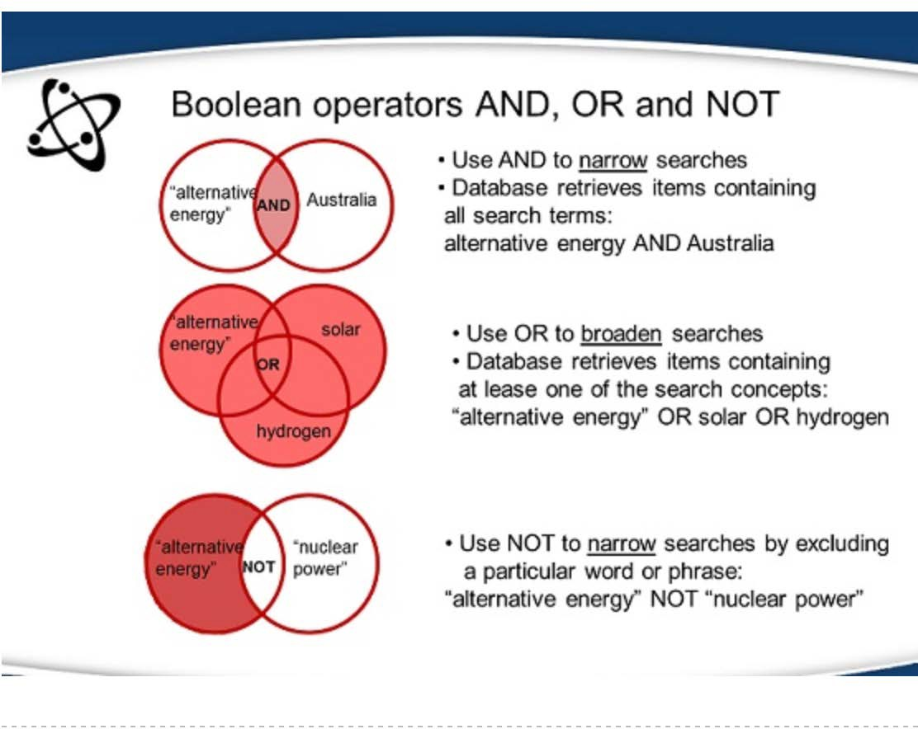
Combining keywords

Slide 11
Activity
Go to NBD1100 Built Environment Communication and Skills library guide
http://libraryguides.vu.edu.au/NBD1100
Click on Getting started with your assignments tab
Scroll down to Learning Activity: Entering Keywords https://padlet.com/dana_kuljanin/8git8v7mkol2

Slide 12
Which sources? References can be drawn from:
Journal articles
Texbooks
Book chapters
Reports
Conference papers in conf. proceedings
Newspapers or magazines
Theses

Slide 13
Places to look for literature?
What literature will you find in which sources?
Library Search
Databases A-Z
Internet: Google Scholar/Google

Slide 14
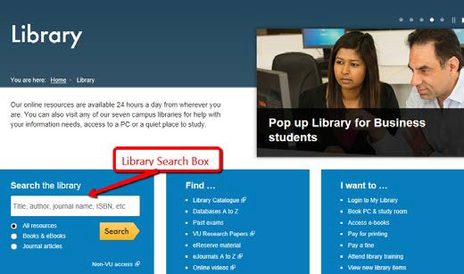
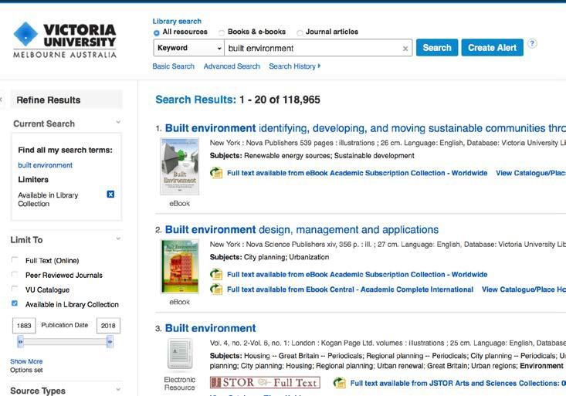
Library Search
Library Search Box defaults to finding ALL search terms.
Click Advanced Search for Boolean logic searching (combine search terms with AND, OR & NOT).
Limit search to
Full-text (Online)
Peer Reviewed Journals
VU Catalogue
Date Slider – Limits by
Publication year
*Video How to access and use e-books from the Library Search*
14

Slide 15
Library resources beyond VU
BONUS - Requesting Books
ArticleReach - Requesting Journal Articles
Visit & Borrow from other university libraries: CAVAL reciprocal borrowing scheme

Slide 16
Project Management Databases – via databases A -Z
Business Source Complete (Ebsco)
Engineering Collection (Informit) Taylor & Francis Online
ARCH (Australian Architecture Database) ASCE Journals
ScienceDirect

Slide 17
Skills
Relevant to all subjects throughout your degree
Relevant to becoming a lifelong learner and professional in the workforce
  Accessing, evaluating and analysing information

Slide 18
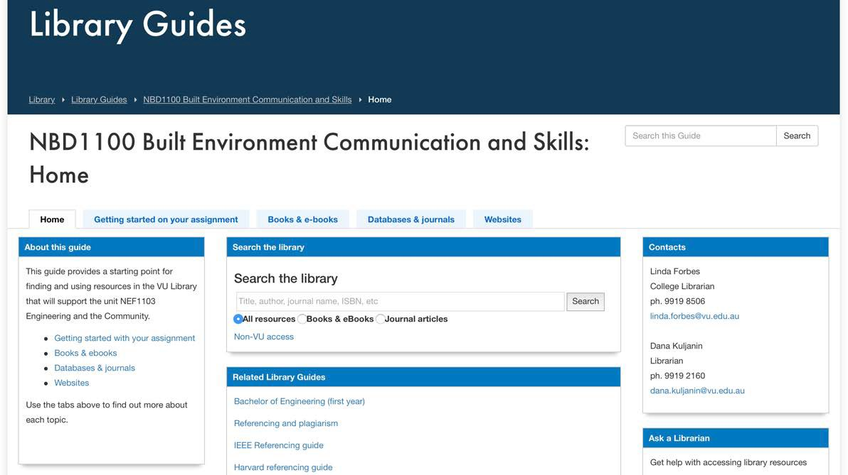
Online library guide
Library Homepage – Course Resources– Library Unit Guides: NBD1100 Built Environment Communication and Skills

Slide 19

Why reference?
To show respect for the original source.
To demonstrate that you have done the research. To show what research you've done.
To avoid plagiarism.

Slide 20
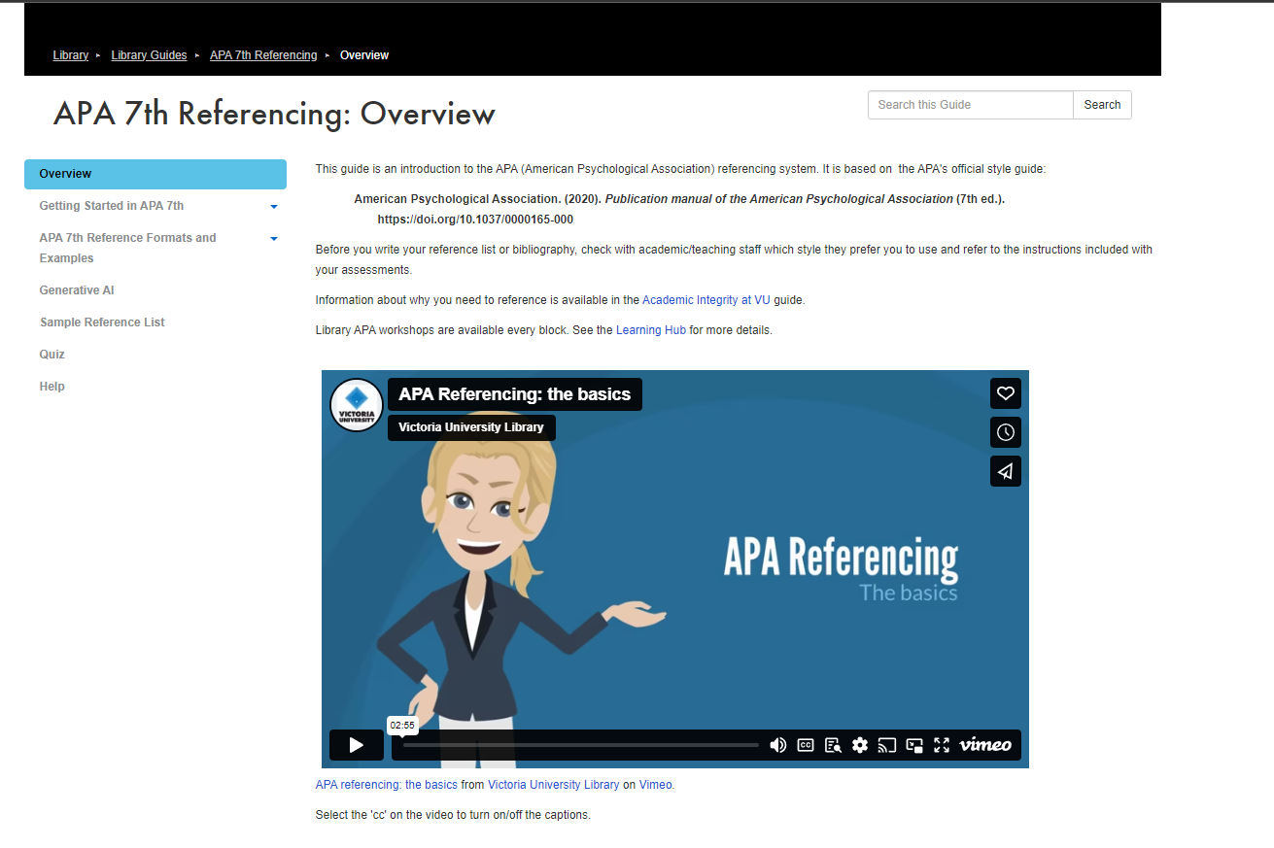
APA 7th referencing style

Slide 21
Evaluating resources
Evaluate anything that you find before including it in your assignment. Reminder: Looking for ‘reputable sources’.
Anyone can author or publish material on a web site. No quality control process is required.

Slide 22
Evaluating criteria
Authority
  Who authored the content and what is their expertise?
  What was is the intended audience?
  What type of site is it?
Accuracy
  Are any claims made, supported by evidence?
  Are facts and figures presented referenced?
  Does the site reference other sources?
Currency
  Does the information presented have a "published" date?
  When was the last time the site was updated?

Slide 23
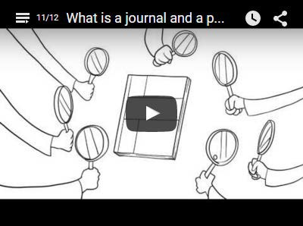
What is a journal and a peer reviewed article
Source: Ronald Williams Library, Northeastern Illinois University

Slide 24
Journal subscriptions
Print journals
  The library subscribes to print copies of journals and puts them onto the library shelves.
Online journals
  The library subscribes to online databases which are collections of journals packaged together by topic.
  These databases can be searched using keywords, author names and subjects.

Slide 25
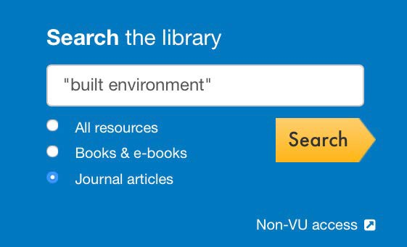
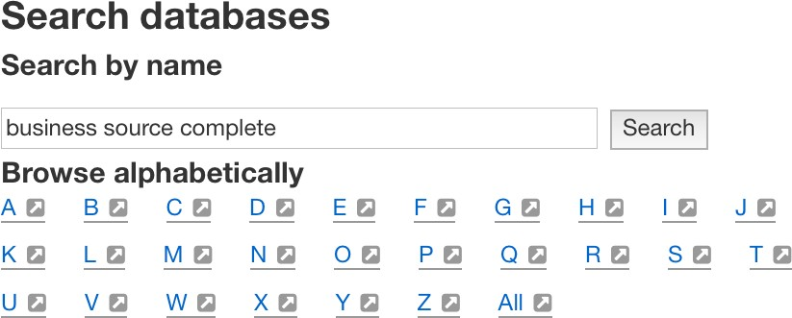
How to find journal articles
Library search
  Enter article title, author or keywords
  Choose journal articles button and search
  Limit to: full text, (also publication date and peer reviewed journals, if desired)
Database searching
  Search the databases by name or browse alphabetically or by subject.

Slide 26
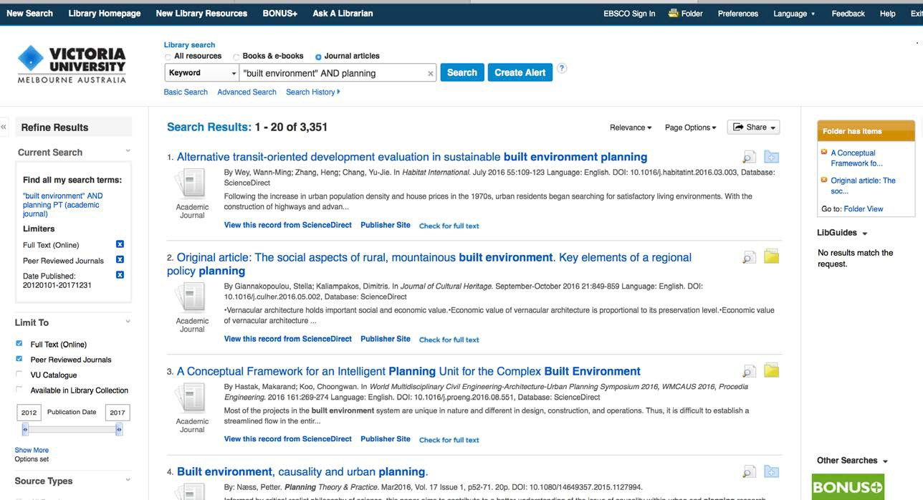
Library Search - Refining search

Slide 27
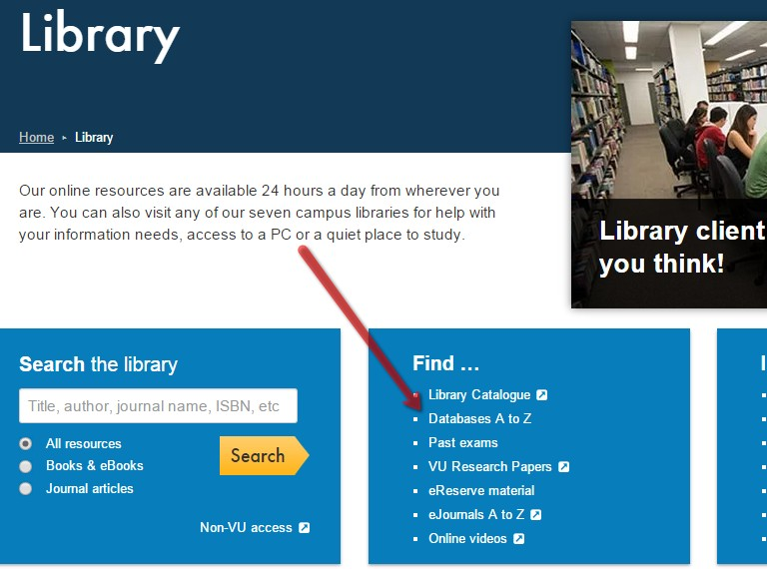
Business Source Complete
Through Databases A-Z on library homepage
Video on how to find and use a Library Database
Business Source Complete video (Seminole State Library)
Link to Business Source Complete Database

Slide 28
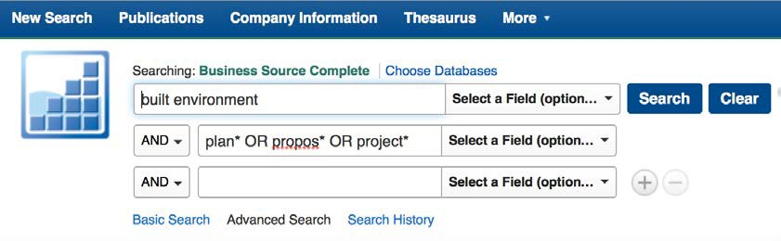
Business Source Complete - refining a journal article search
Peer reviewed (in Advanced Search)
Date
Use more specific keywords than in ‘Library Search’
Can put in a folder and send articles to yourself
Search examples

Slide 29
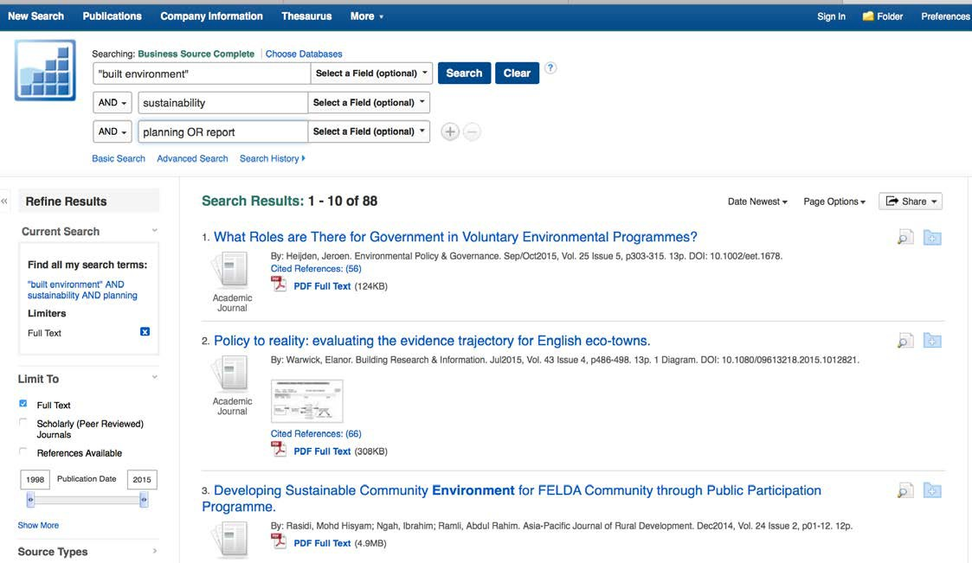
Business Source Complete - refining search

Slide 30
Activity
Using the Library search OR the Business Source Complete database, find 1 journal article that you will use in your assessment task 1 and email the article to yourself in Harvard format.

Slide 31
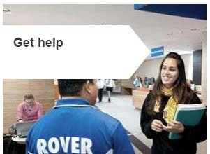

Need more help?
Use Ask a Librarian OR Live chat service http://askalibrarian.vu.edu.au/
Ask a library staff member if on campus
Go to the library guide
http://libraryguides.vu.edu.au/NBD1100
33

